Slide 1
Android Studio Setup
Prepare your environment for Android

Slide 2
Android Bundle
Setting up the Development Environment

Slide 3
Android Studio -- Why?
Android Studio is the latest development environment Google recommends for Android. It is based on IntelliJ IDEA which is faster and lighter than Eclipse.
When developing apps for Android, we will need Java SDK, Android SDK as well as the Android Studio IDE.

Slide 4
Installing the Java SDK
If you don’t have the Java 8 SDK, let’s install that first.
1. Go to http://www.oracle.com/technetwork/java/javase/downloads/index.html
2. Choose your platform, note that 32-bit and 64-bit versions are both available
3. Download and install the JDK 8, Java Development Kit (NOT just the JRE)

Slide 5
Installing Android Studio
Download Android Studio which also includes an initial setup for Android SDK tools:
1. Download Android Studio http://developer.android.com/sdk/installing/studio.html#download
2. For OS-specific instructions, follow: http://developer.android.com/sdk/installing/index.html?pkg=studio
3. Launch Android Studio Application

Slide 6
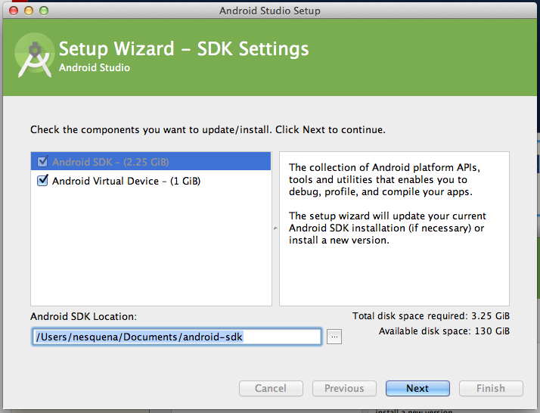
Installing Android SDK
Android Studio should now prompt you to download the Android SDK before continuing.
Check “Android Virtual Device”
Select an SDK Location you will remember; name folder “android-sdk”
Click “Next” to start install.

Slide 7
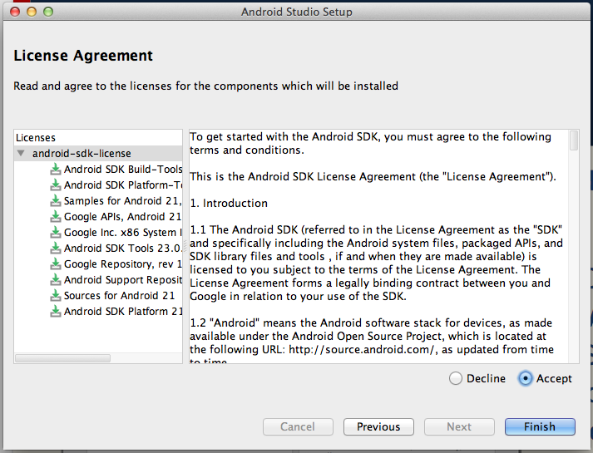
Installing Android SDK
Android Studio should now prompt you to accept the licenses for the SDK.
Select the item with the arrow on the left.
Select “Accept”
Click “Finish”
Wait for Setup...then hit “Finish” again

Slide 8
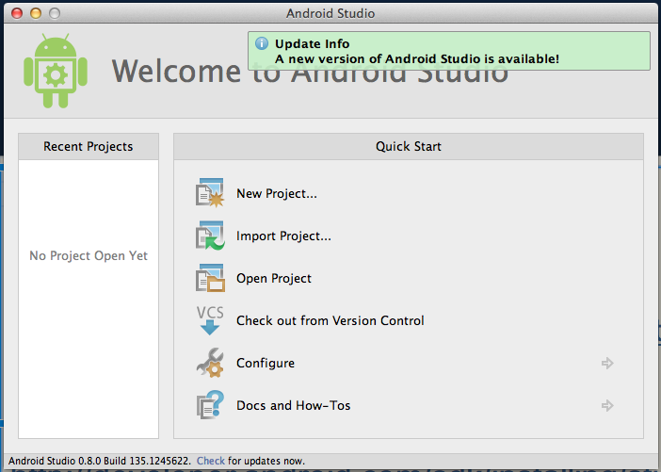
Check for Updates
1. Make sure to check for the latest updates.
2. Press “Update and Restart” if there is an update.

Slide 9
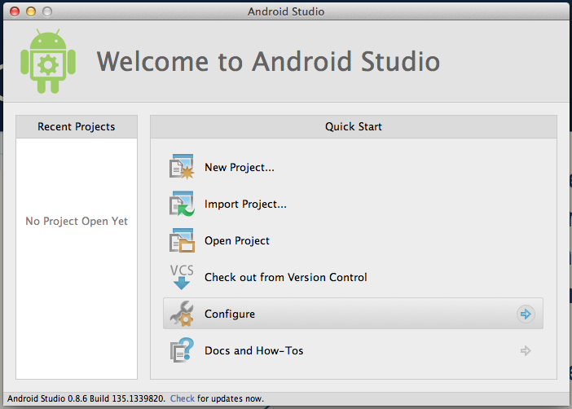
Configure
Select “Configure” in Menu

Slide 10
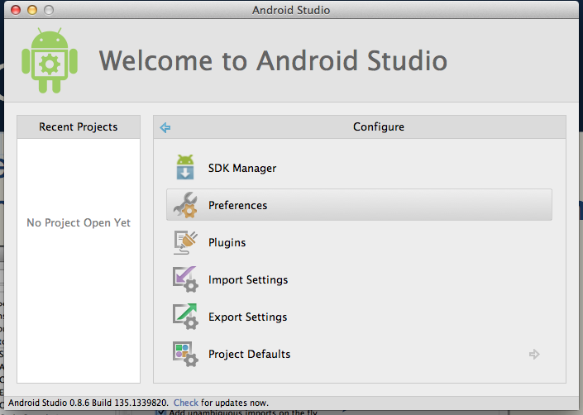
Configure Preferences
Select “Preferences” in Menu

Slide 11
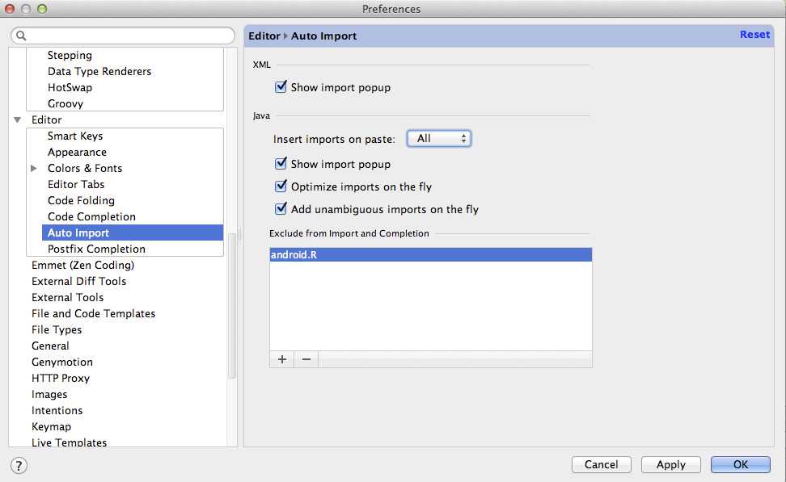
Configure Imports
1. Set “Imports on Paste” to “All”
2. Click “Optimize imports on the fly”
3. Check “Add unambiguous imports on the fly”
4. Exclude android.R from auto-imports

Slide 12
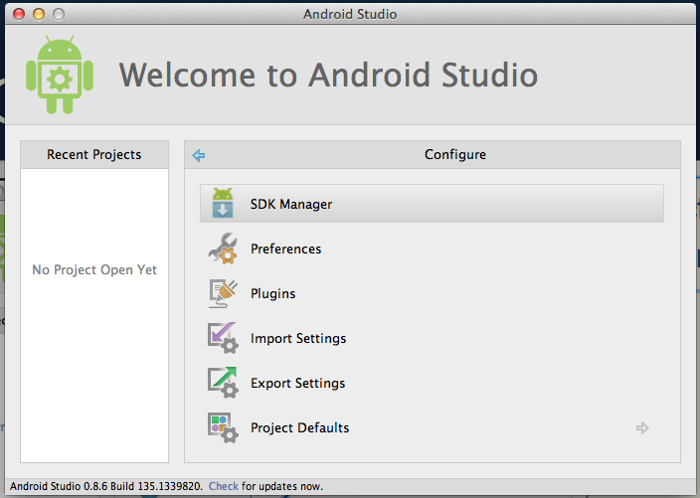
Configure SDKs, Pt 2
Select “SDK Manager” in Menu

Slide 13
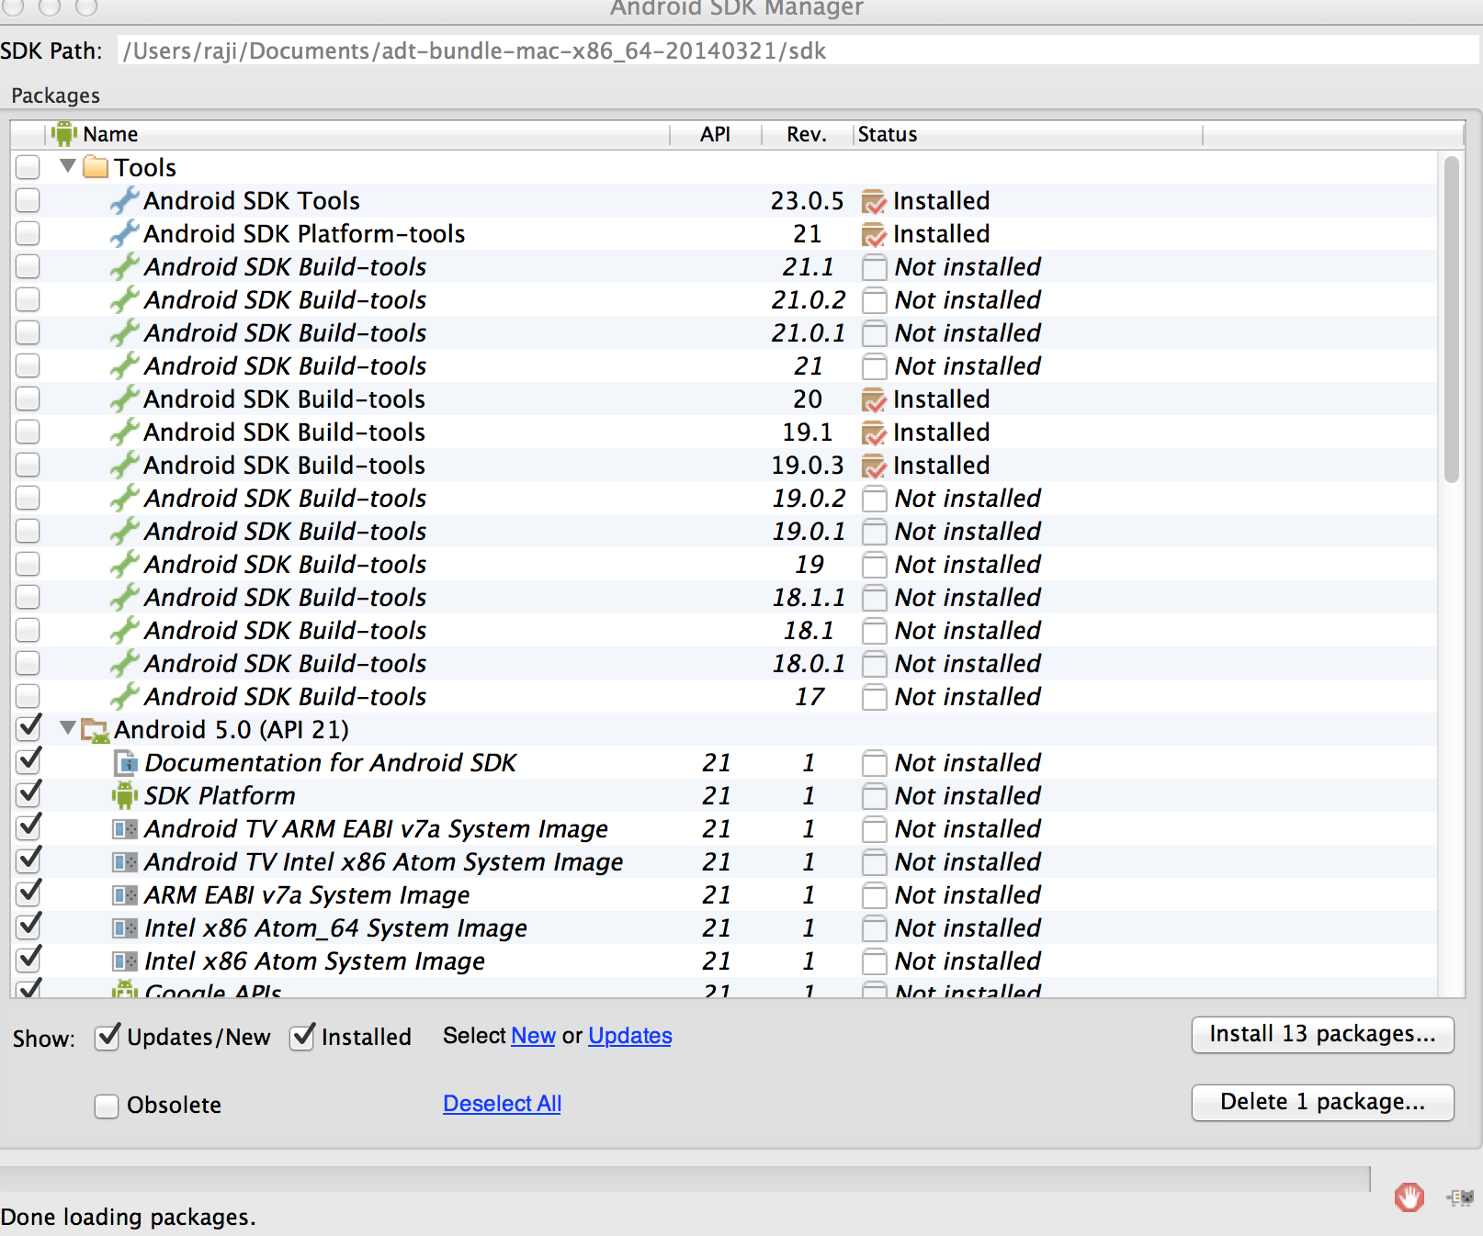
Configure SDKs, Pt 3
Select “Deselect All” from SDK Manager
Make sure all packages have been de-selected.

Slide 14
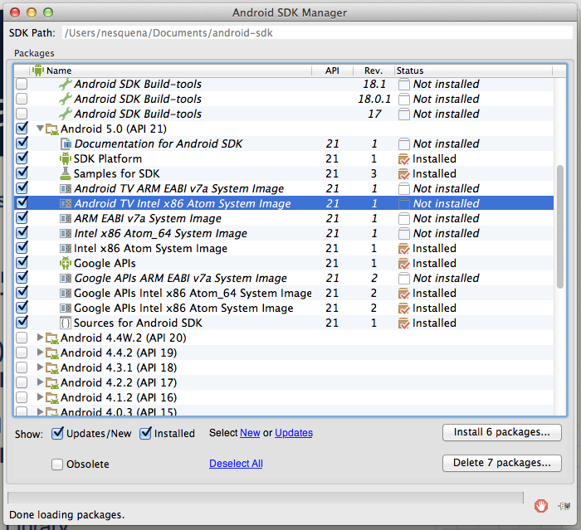
Android add-ons, 1
Check the following boxes:
Android SDK Tools
Android SDK Platform-tools
Android SDK Build Tools (21)
Android 5.0 (API 21)
Doc, SDK, Samples, Intel x86, APIs
Android 4.4.2 (API 19)
Doc, SDK, Samples, Intel x86, APIs
Extras
Android Support Library
Google USB Driver (Windows)

Slide 15
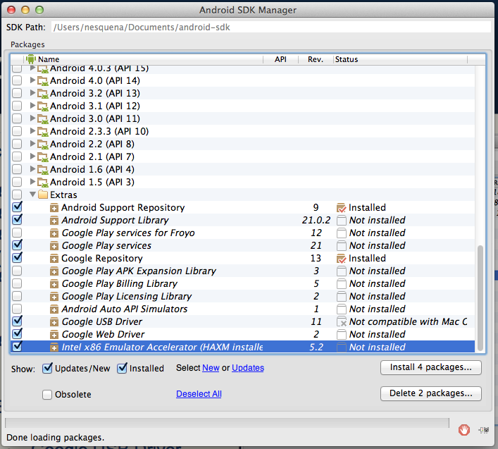
Android add-ons, 2
Check the following boxes:
Android SDK Tools
Android SDK Platform-tools
Android 5 (API 21)
Doc, SDK, Samples
Extras
Android Support Library
Google Play services
Google USB Driver (Windows)
Intel x86 HAXM
Select 'Install packages...'

Slide 16
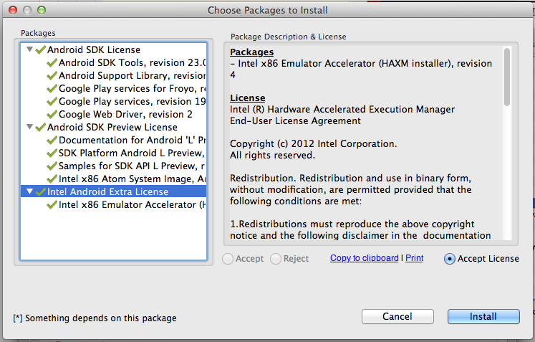
Android add-ons, 3
Accept License for all 3 groups and hit Install

Slide 17
Android emulators
Running Android Apps in Android Studio

Slide 18
Emulator -- Why?
Android Development requires us to try the apps we are building while they are being built.
While this can be done by plugging in an Android device, usually it is easier to use an Emulator.
An Emulator runs the app in a virtual Android on our computer through Android Studio.
We need to install the Intel x86 HAXM emulator in order to have a smooth emulator experience while testing complex applications.

Slide 19
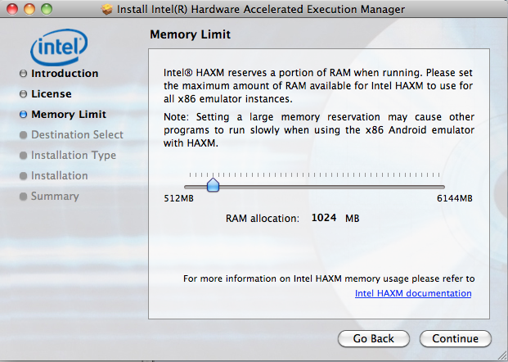
Install Intel x86 Accelerator
Download Intel HAXM Emulator installer
Run the installer executable and a wizard will be displayed
Hit Next and select at least 512 MB for memory and continue to hit Next
Verify the installation completes successfully.
Note: Make sure to download the latest available hotfix on the HAXM website for your platform.

Slide 20
Troubleshoot: Intel HAXM
In order for Intel HAXM to work, your computer must support virtualization. In some cases, computers support virtualization, but it is not enabled in the BIOS. In this case, when you try to install Intel HAXM, it will say something like:
"Your hardware supports virtualization, but it is not enabled. Restart your computer, navigate to your BIOS system settings and enable virtualization."
Enable VT Guide (Microsoft Windows): http://www.microsoft.com/windows/virtual-pc/support/configure-bios.aspx
(OSX machines usually have virtualization support already enabled.)

Slide 21
Open up Virtual Devices
Select “SDK Manager” in Menu

Slide 22
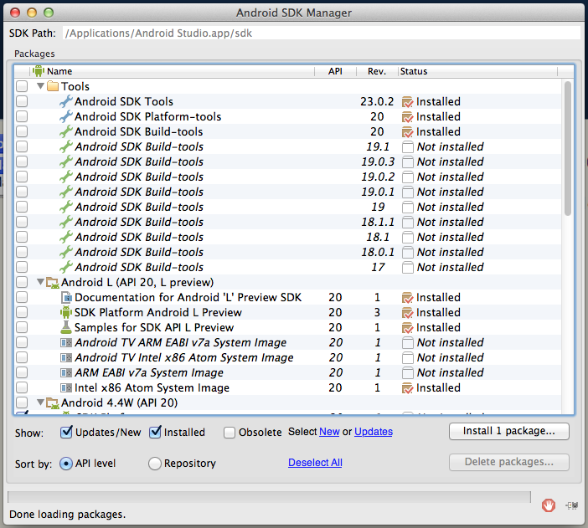

Open up Virtual Devices
With the SDK Manager Opened…
In the Menu Toolbar:
Select Tools → Manage AVDs...

Slide 23
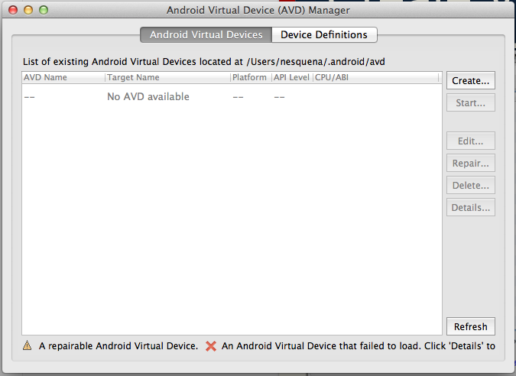
Create Virtual Device
Select Create… to add new virtual device

Slide 24
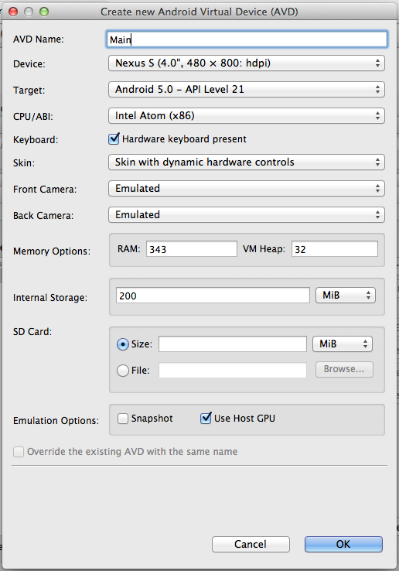
Setup Virtual Devices
AVD Name: Main
Device: Nexus S
Target: Android 5.0
CPU: Intel Atom (x86)
Skin: Dynamic
Check Use Host GPU
Click OK
Don't See Intel x86 for CPU?
Be sure you have Intel x86 Atom System Image for the target version and have fully restarted Android Studio after running the Intel x86 HAXM installer.

Slide 25
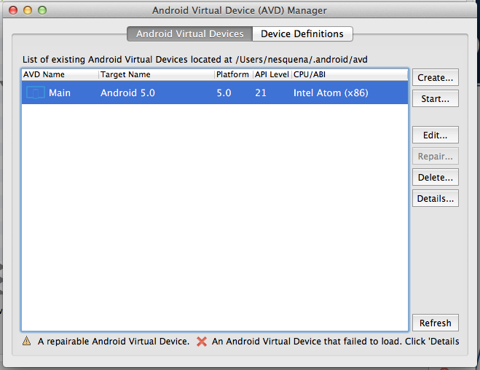
Launch Android Emulator
For the emulator that you create, try clicking on "Start..." to then select Launch. Starting the emulator for the first time make take a few minutes. Don't close the window once it has booted.

Slide 26
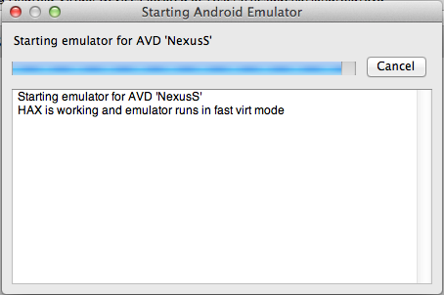
Check for "fast virt mode"
If Intel HAXM is set up correctly, as you launch the emulator, you should see the text, "HAX is working and emulator runs in fast virt mode".

Slide 27
Git
Version control with Android Studio

Slide 28
Git -- Why?
When developing software, we should always use version control to manage our code.
Version control with Git is a way to backup our code, create a version history as we make changes and collaborate on code with other developers.
For our purposes, we will be using GitHub to store our code. GitHub is a free service for managing our code and saving a backup in the cloud.
We will also download and run our first Android application using Git.

Slide 29
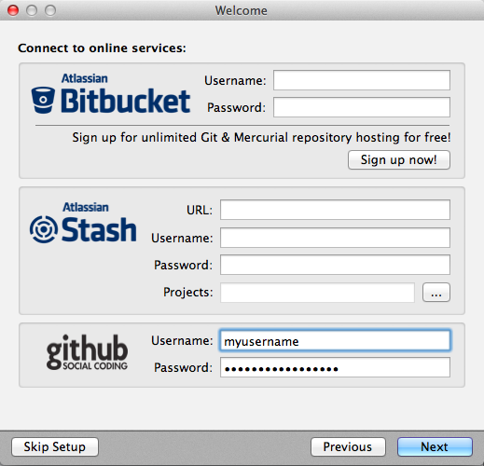
Setup Git Client
Download the client from http://www.sourcetreeapp.com
Install the sourcetree client for your platform and launch the application.
Follow the setup wizard, verify your name and email, and enter your Github account details (optional).
Note: Or you can just use git from the command-line. If you already know git, this is recommended!

Slide 30
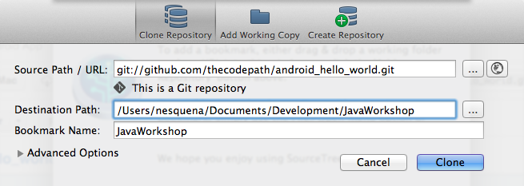
Clone HelloWorldDemo
Open SourceTree
Click File → New / Clone
Select Source Path as https://github.com/thecodepath/android_hello_world.git
Select a Destination Path within Studio Workspace
Confirm the repository is listed within SourceTree UI

Slide 31
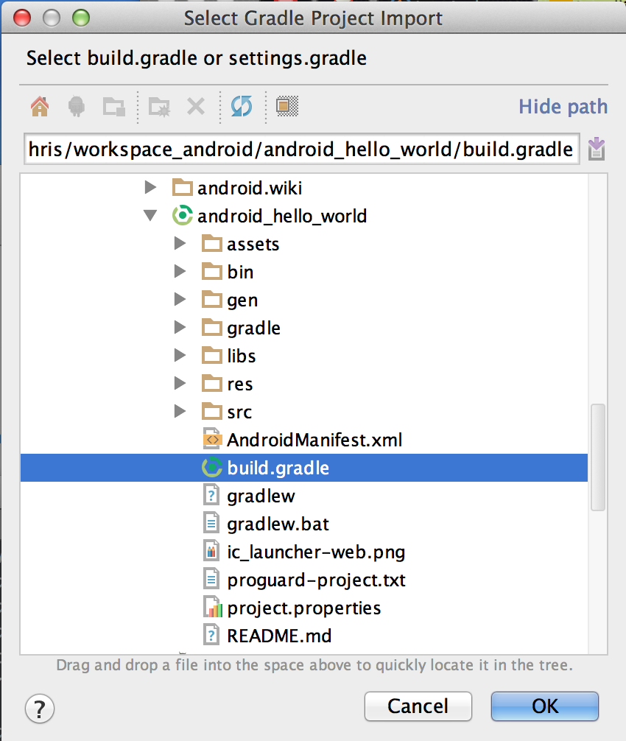
Import HelloWorldDemo
In Android Studio, select Import Project...
In the dialog, select build.gradle under the android_hello_demo path cloned through Source Tree
Click "Ok" to Load the Project

Slide 32

Confirm Installation
In Android Studio, click on Run → Run ‘android_hello_world’
Emulator should startup, and eventually load in separate window
You should see the application running in the emulator!

Slide 33
Wrapping Up
Ensuring Setup is Complete

Slide 34
In Review
We have now finished setting up our Android environment including:
Java and Android SDK
Android Studio IDE
Android Emulator
Git Source Control
Our First Android Application

